Slide 1
Lane Segmentation Week 2
HCT CV Class

Slide 2
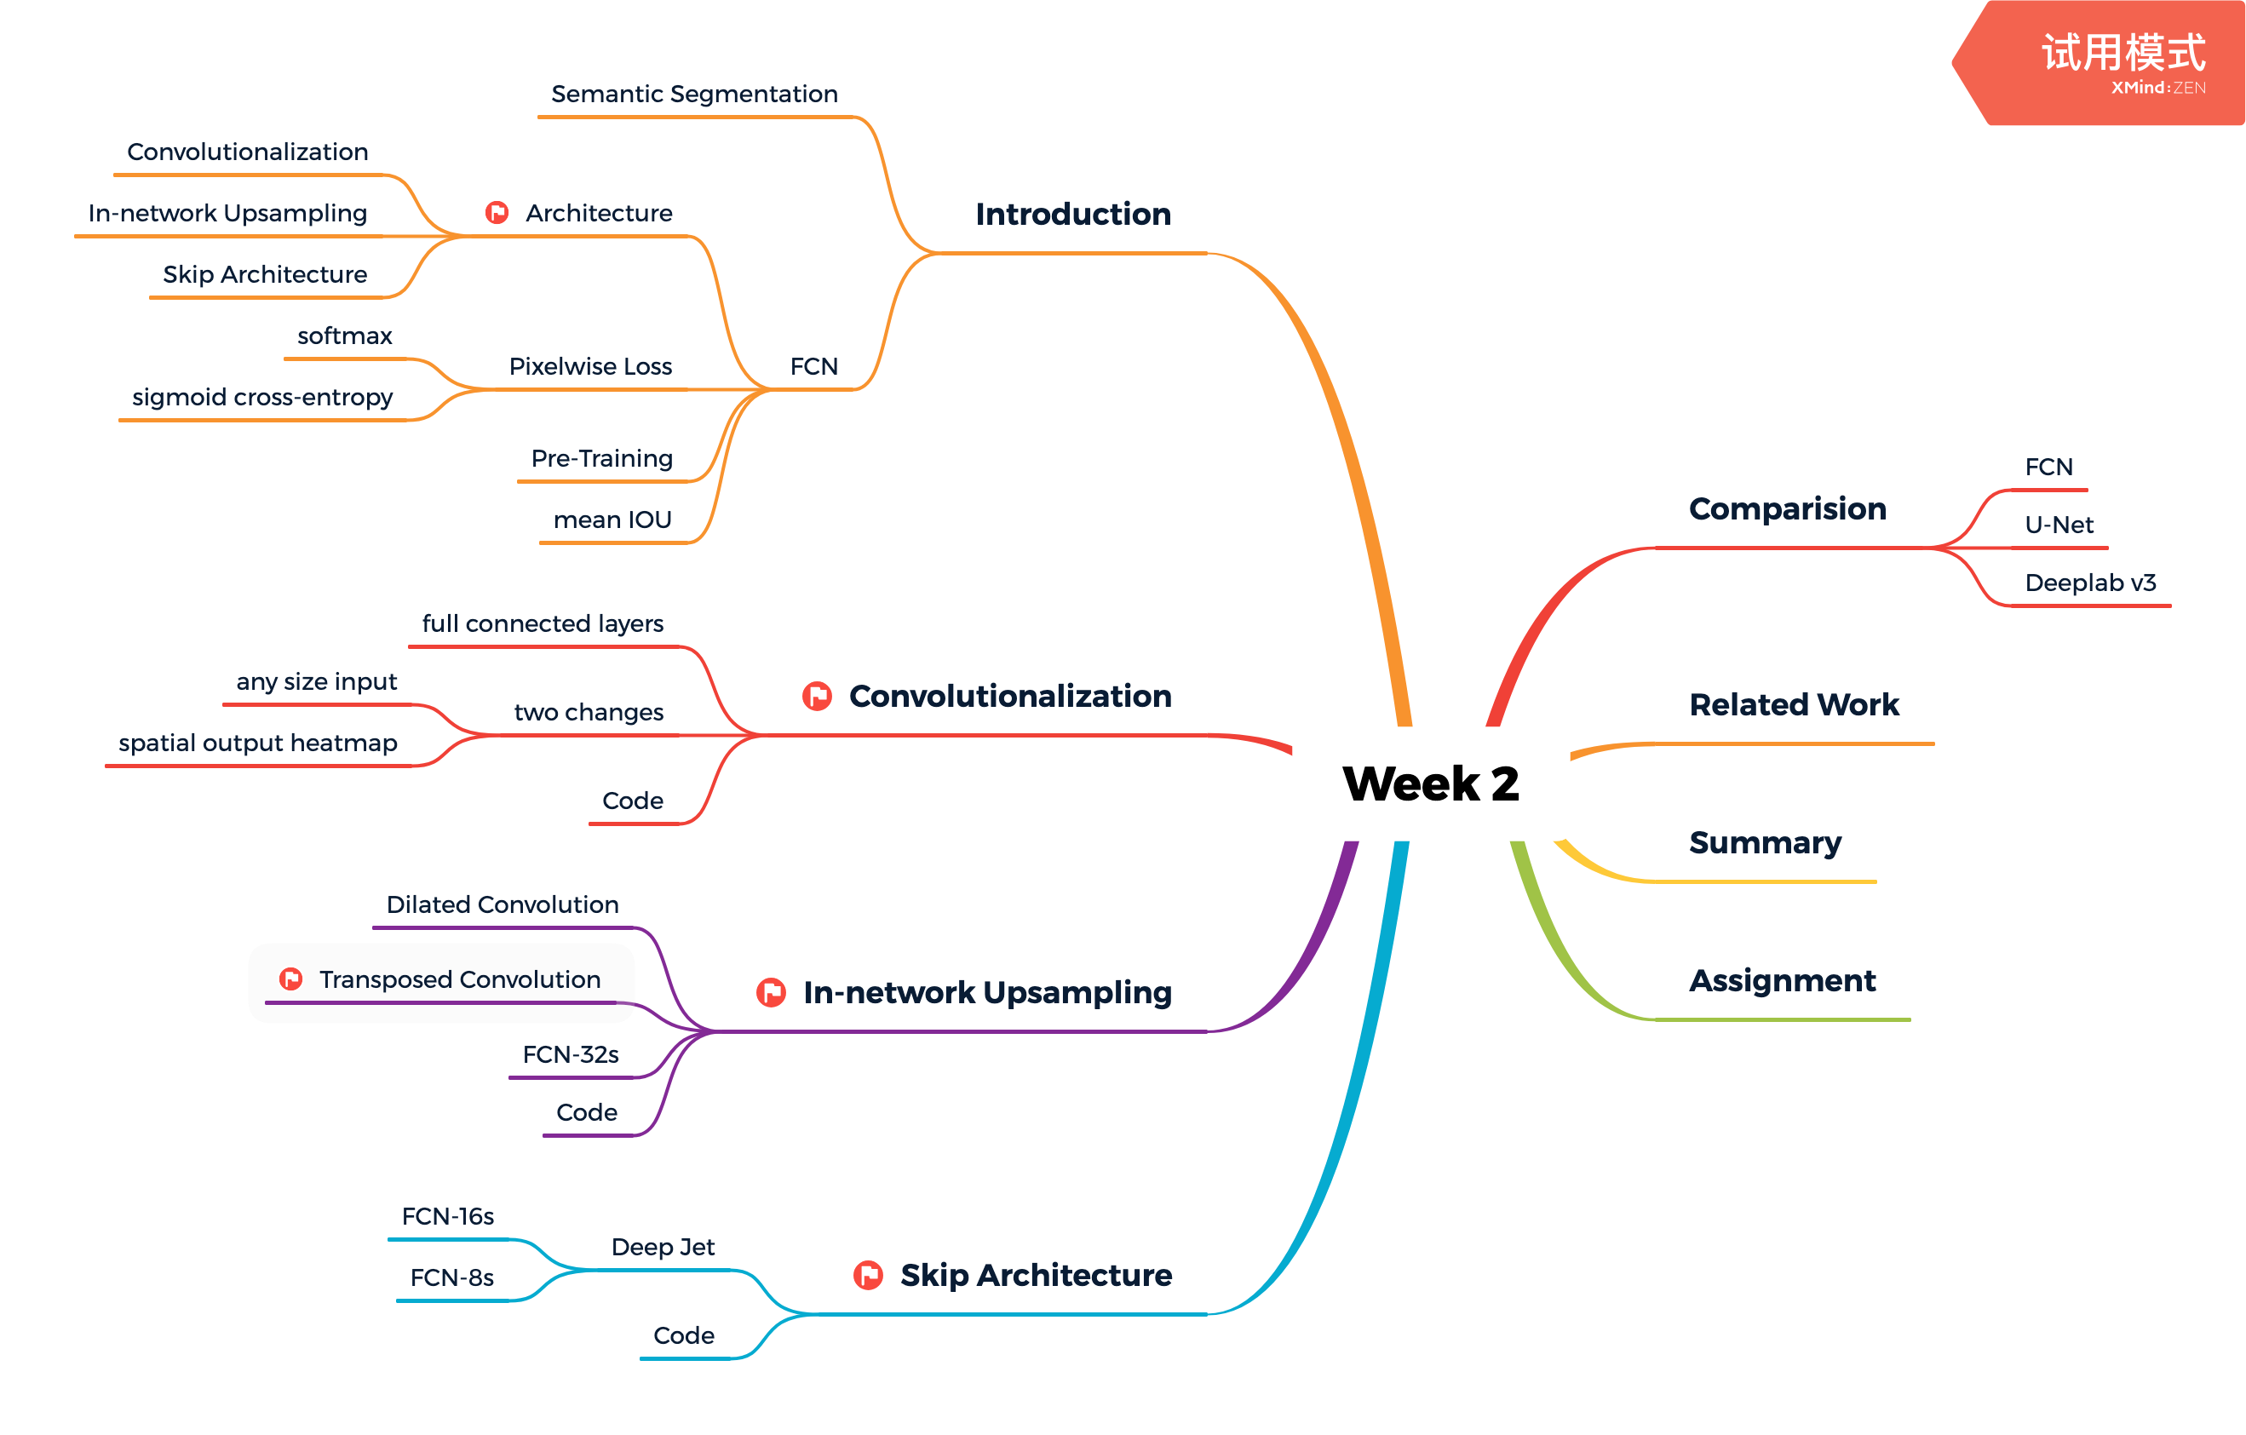

主要内容

Slide 3
学习目标
理解FCN的原理
掌握FCN的关键技术点
掌握FCN的实现

Slide 4
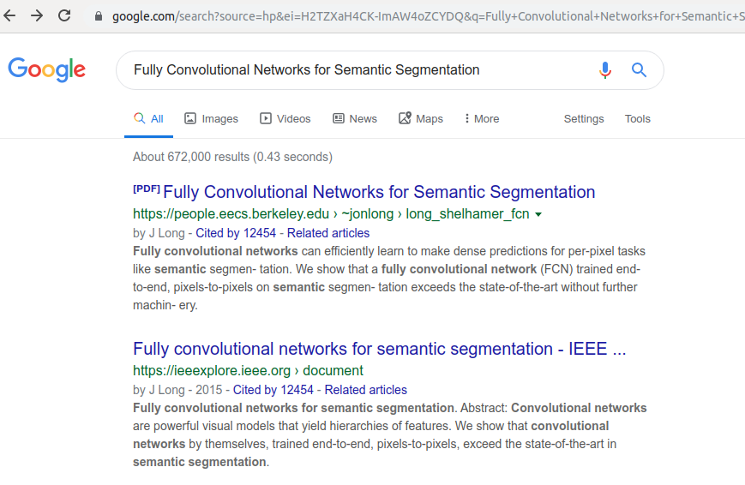
FCN

Slide 5
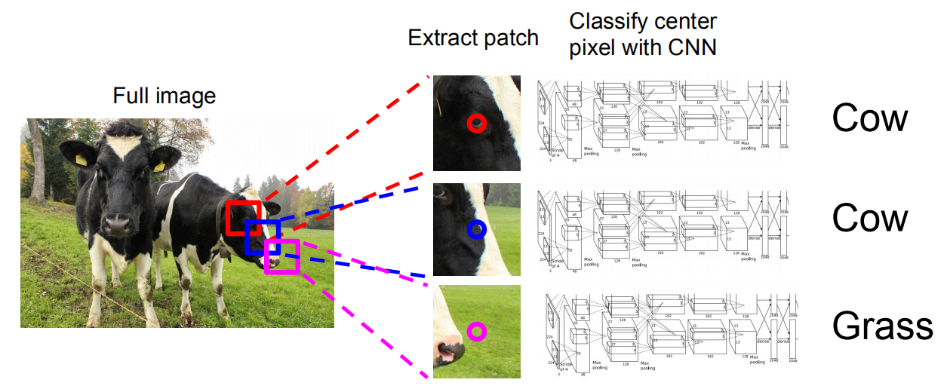


Before FCN
使用传统特征
Sliding Window + Classifier

Slide 6
FCN原理
Fully convolutional versions of existing networks predict dense outputs from arbitrary-sized inputs. Both learning and inference are performed whole-image-at-a-time by dense feedforward computation and backpropagation. In-network upsampling layers enable pixelwise prediction and learning in nets with subsampled pooling.

Slide 7
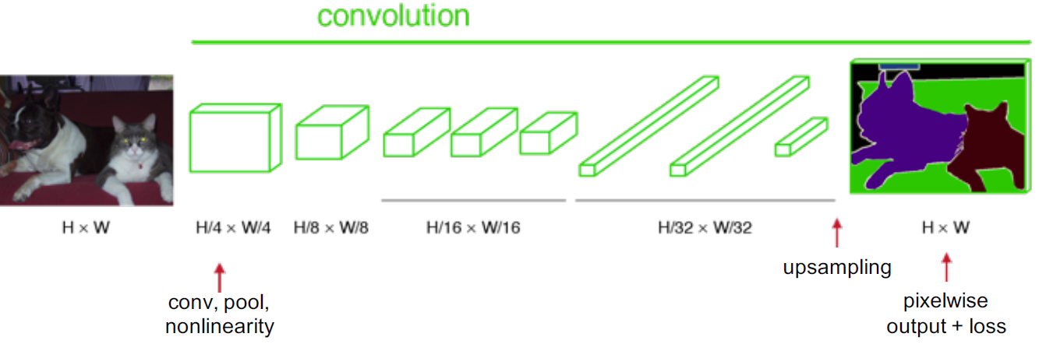
Convolutionalization

Slide 8
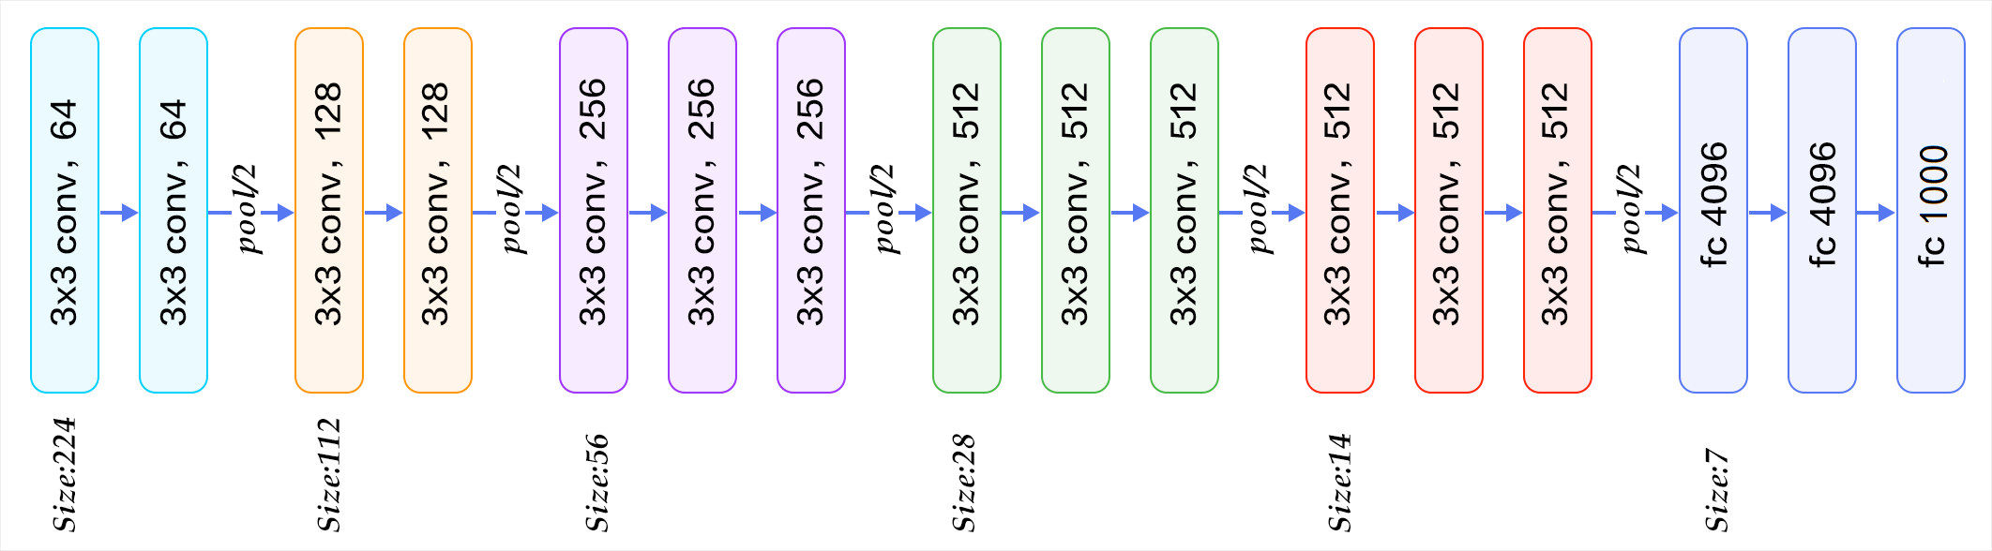

VGG16

Slide 9
VGG16
nn.Conv2d(3, 64, 3, padding=100)
nn.ReLU(inplace=True)
nn.MaxPool2d(2, stride=2, ceil_mode=True)
nn.Dropout()

Slide 10
VGG16
import torch
class VGG16(torch.nn.Module):
def __init__(self, n_class=21):
pass
def forward(self, x):
pass

Slide 11
Classify CNN
fix-size input
non-spatial output

Slide 12
卷积层 as 全连接层
转置卷积

Slide 13
全连接层 as 卷积层
全卷积(full sized kernel)

Slide 14
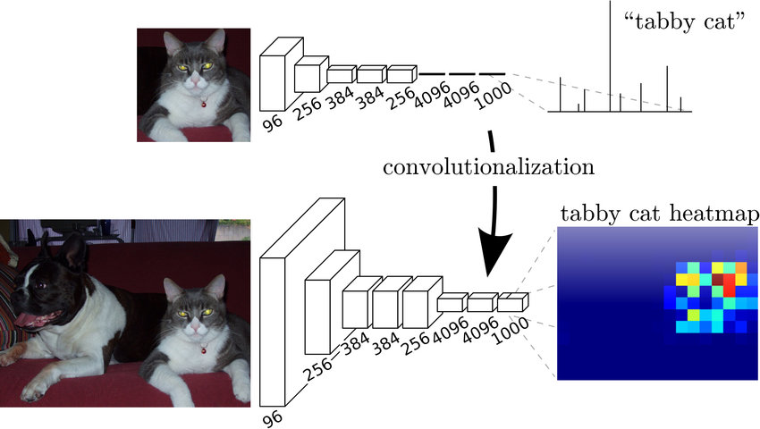
Convolutionalization

Slide 15
Full Convolutional Network
a net with only layers of this form computes a nonlinear filter, which we call a deep filter or fully convolutional network
A real-valued loss function composed with an FCN defines a task

Slide 16
VGG16-Conv
import torch
class VGG16Conv(torch.nn.Module):
def __init__(self, n_class=21):
pass
def forward(self, x):
pass

Slide 17
VGG16-Conv
Conv1：padding = 100
o = [ (i + 2p - k)/s ] +1

Slide 18
VGG16-Conv
全卷积结束的位置

Slide 19
In-network Upsampling
connect coarse outputs to dense pixels

Slide 20
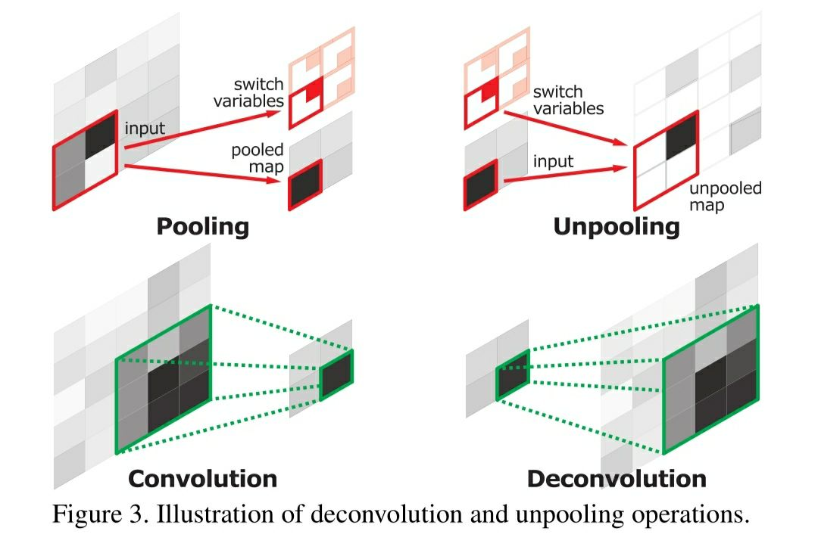
In-network Upsampling
connect coarse outputs to dense pixels

Slide 21
Transposed Convolution
“A guide to convolution arithmetic for deep learning”

Slide 22
Transposed Convolution
class torch.nn.ConvTranspose2d(in_channels, out_channels, kernel_size, stride=1, padding=0, output_padding=0, bias=True)
output_padding？
Set Parameters for upsampling N times

Slide 23
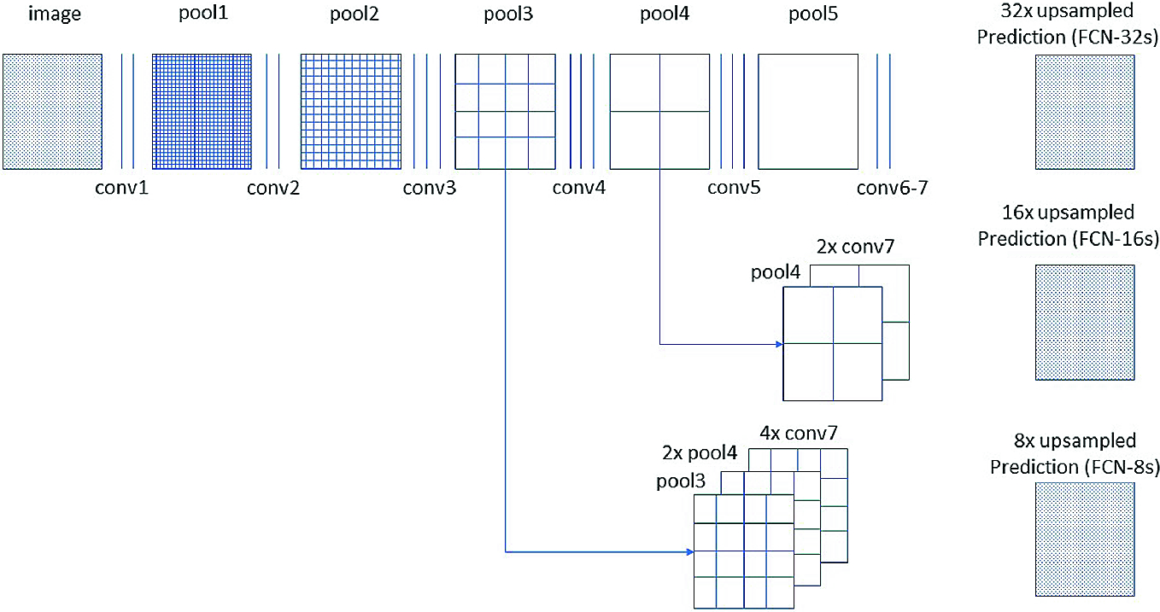
FCN-32s

Slide 24
FCN-32s
import torch
class FCN32s(torch.nn.Module):
def __init__(self, n_class=21):
pass
def forward(self, x):
pass

Slide 25
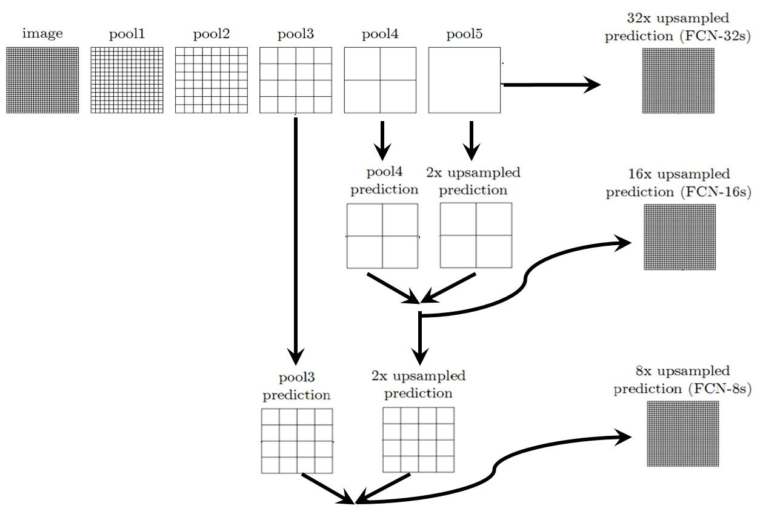
Skip Architecture

Slide 26
Skip Architecture
维度一致才能相加：spatial/channel
1x1 Convolution

Slide 27
FCN-16s
import torch
class FCN16s(torch.nn.Module):
def __init__(self, n_class=21):
pass
def forward(self, x):
pass

Slide 28
FCN的效果

Slide 29
FCN的缺点
FCN-8s结果还是不够精细
没有充分考虑像素之间的关系

Slide 30

模型对比

Slide 31
Dilated Convolution

Slide 32
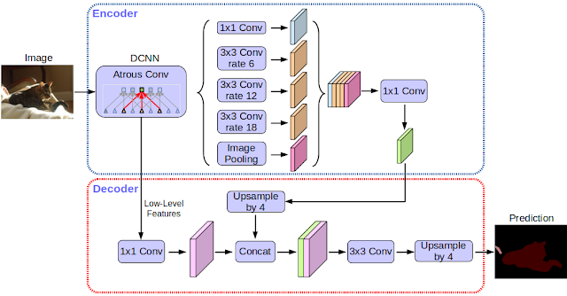
模型对比

Slide 33
课程总结
理解FCN的原理
掌握CNN分类网络的Convolutionalization方法
掌握In-Network Upsampling方法
掌握Skip Architecture提升准确度的方法

Slide 34
重难点
VGG16全卷积化的实现方法
Transposed Convolution(会计算)
Skip Architecture(维度一致才能相加)

Slide 35
课程作业
实现FCN-8s(VGG16)
实现FCN-8s(ResNet101)

Slide 36
课程作业
import torch
class FCN8s(torch.nn.Module):
def __init__(self, n_class=21):
pass
def forward(self, x):
pass

Slide 37
参考资料
Fully Convolutional Networks for Semantic Segmentation
https://arxiv.org/abs/1411.4038
PyTorch Implementation of Fully Convolutional Networks
https://github.com/wkentaro/pytorch-fcn
Caffe Reference Implementation of Fully Convolutional Networks
https://github.com/shelhamer/fcn.berkeleyvision.org

Slide 38
Next Week

Slide 39

一所专注前沿互联网技术领域的创新实战大学

